Slide 1

Heart Data Analysis
Done By: KIRIT P S

Slide 2
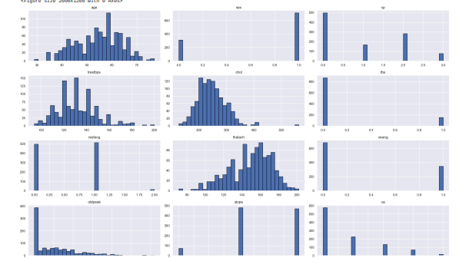
HISTOGRAM
Display the distribution of attributes such as 'thalach', 'exang', 'oldpeak', 'slope', 'ca', 'thal', 'trestbps', etc. These plots give an overview of the frequency of different values within the dataset.

Slide 3
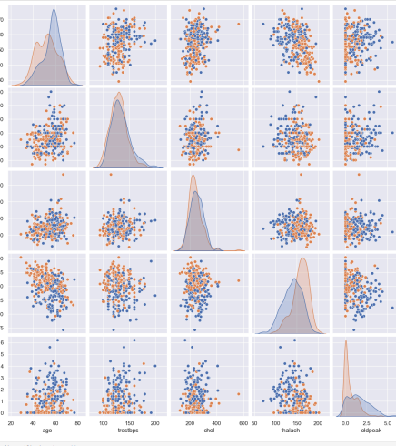
PAIRPLOT
Shows pairwise relationships in a dataset. For example, a pairplot of 'age', 'trestbps', 'chol', 'thalach', 'oldpeak', and 'Heart disease' helps visualize correlations and patterns between these variables.

Slide 4
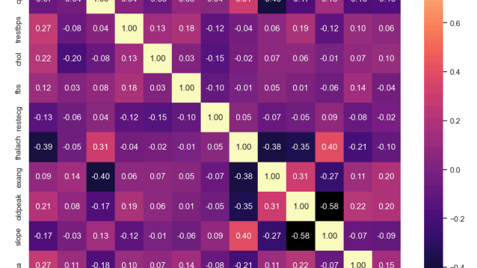
HEATMAPS
Used to show the correlation matrix of different attributes such as 'age', 'sex', 'cp', 'trestbps', 'chol', 'fbs', 'restecg', 'thalach', 'exang', 'oldpeak', 'slope', 'ca', 'thal'. Heatmaps provide a visual representation of the strength and direction of correlations between variables.

Slide 5
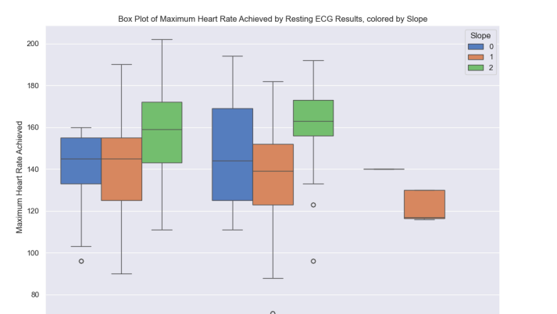
BOXPLOT (Heart Rate by Resting ECG and Slope)
Description: A box plot showing the distribution of maximum heart rate achieved (thalach) across different Resting ECG results (restecg), with data points colored by the slope
Usage: It is useful for comparing the median and spread of heart rate values across different ECG results and slopes.

Slide 6
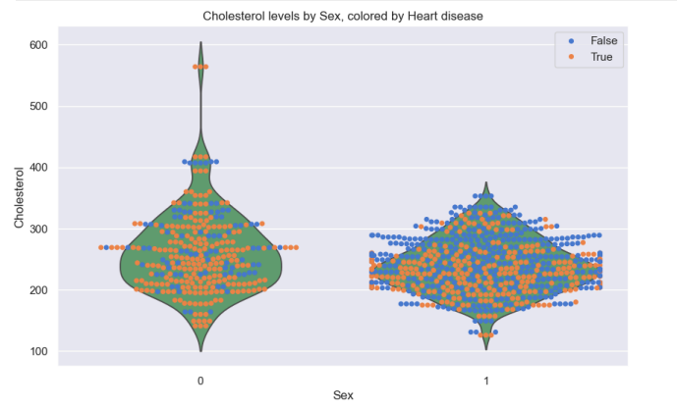
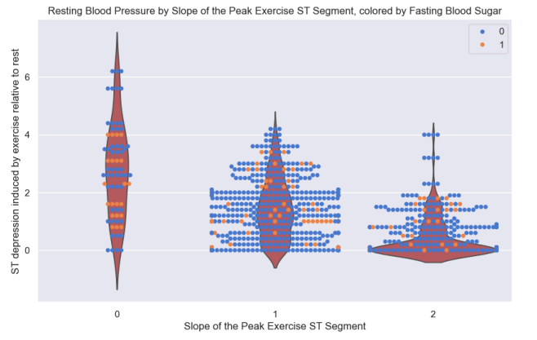
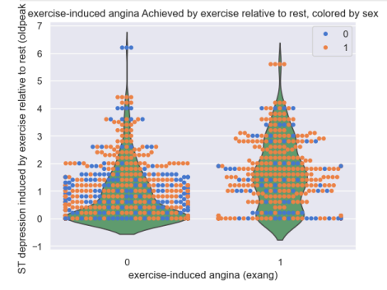
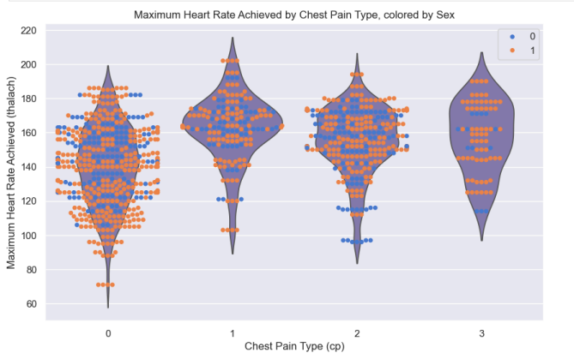
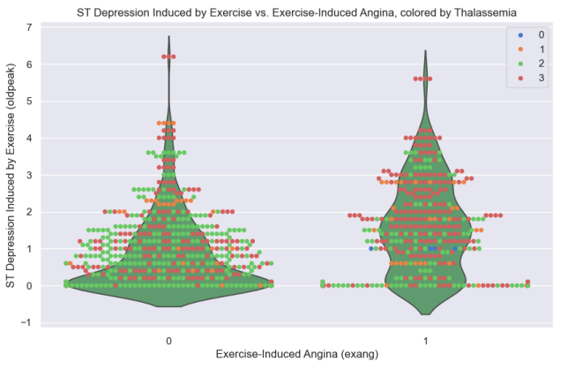
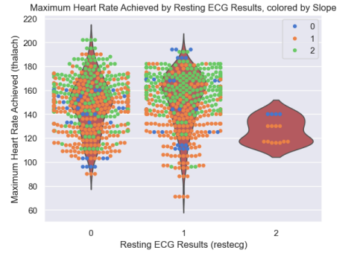
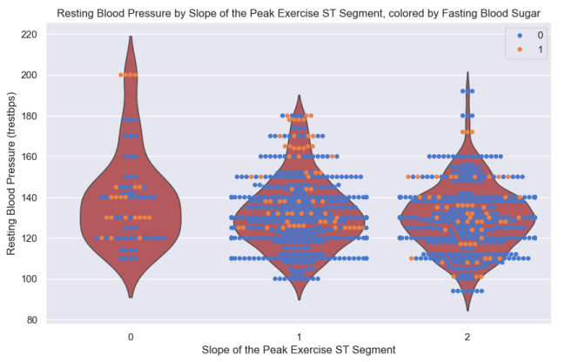
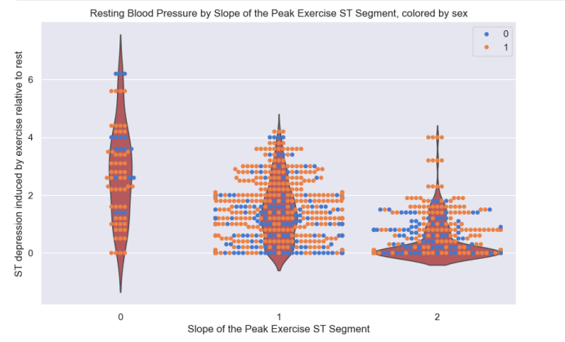
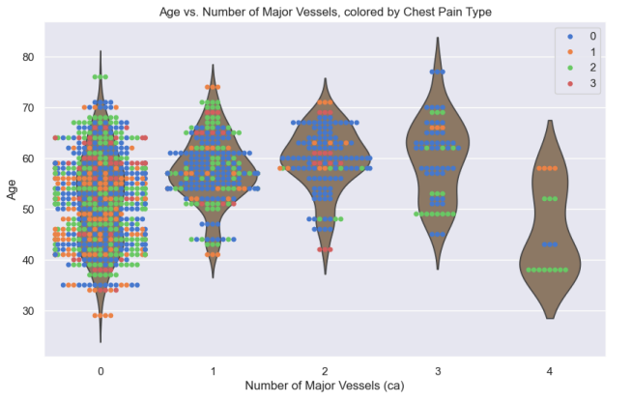
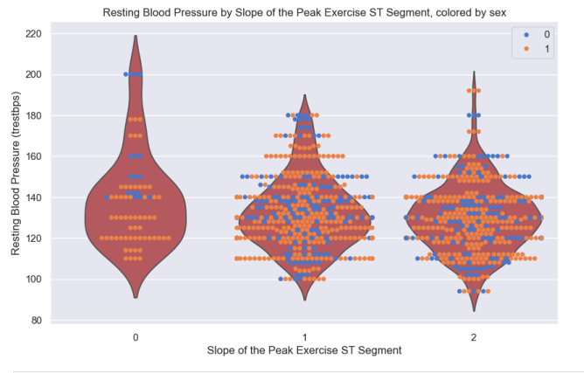
Swarmplot With Violinplot
Combined to show the distribution of data points for variables like 'sex' and 'chol', 'cp' and 'thalach', 'slope' and 'trestbps'. The swarmplot shows individual data points, while the violin plot adds a KDE estimation.

Slide 7
Swarmplot With Violinplot (Resting ECG and Heart Rate)
Description: This graph combines a swarm plot and a violin plot to display the relationship between the Resting ECG results (restecg) and the Maximum Heart Rate Achieved (thalach). The data points are colored by the slope category.
Usage: It helps to visualize the distribution and density of heart rate values across different ECG results and slopes.

Slide 8

Swarmplot With Violinplot (Exercise-Induced Angina and ST Depression)
Description: This graph combines a swarm plot and a violin plot to display the relationship between the Resting ECG results (restecg) and the Maximum Heart Rate Achieved (thalach). The data points are colored by the slope category.
Usage: It helps to visualize the distribution and density of heart rate values across different ECG results and slopes.

Slide 9
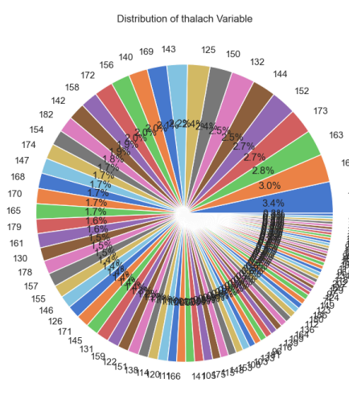
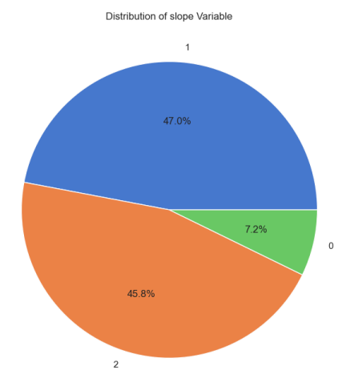
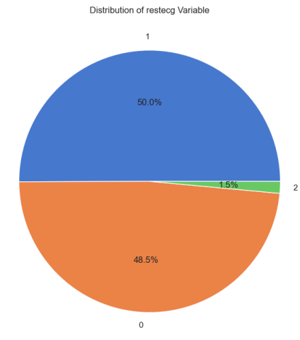
Pie Charts (Distribution of Variables)
Description: Multiple pie charts display the distribution of different categorical variables (restecg, thalach, slope).
Usage: These charts provide a visual summary of the proportions of each category within the respective variables.

Slide 10
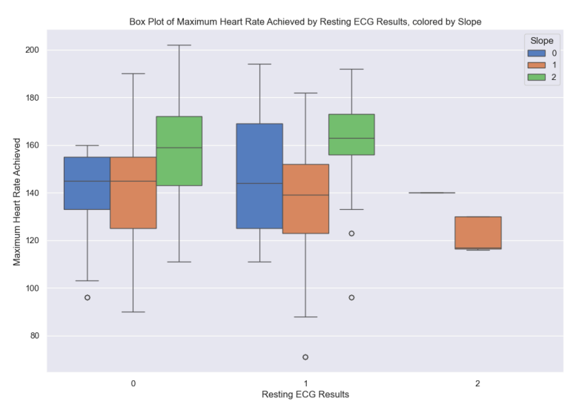
Box Plot (Heart Rate by Resting ECG and Slope)
Description: A box plot showing the distribution of maximum heart rate achieved (thalach) across different Resting ECG results (restecg), with data points colored by the slope.
Usage: It is useful for comparing the median and spread of heart rate values across different ECG results and slopes.

Slide 11
3D Line Plot (Exercise-Induced Angina, ST Depression, and Fasting Blood Sugar)
Description: A 3D line plot showing the relationship between exercise-induced angina (exang), ST depression (oldpeak), and fasting blood sugar (fbs), colored by sex.
Usage: This plot provides a multi-dimensional view of the interactions between these three variables.

Slide 12
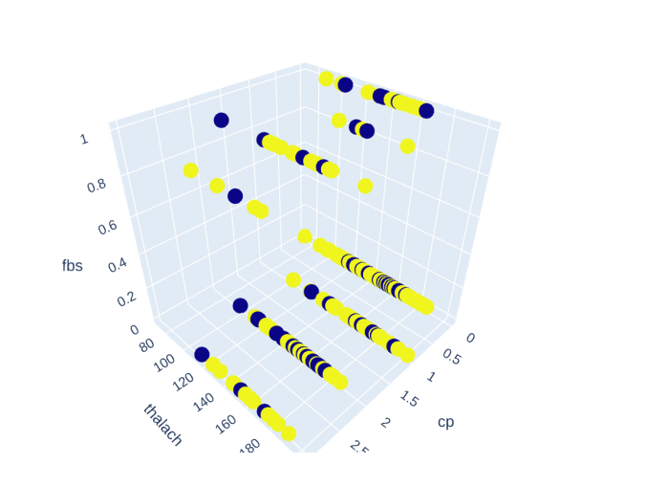
3D Scatter Plot (Chest Pain, Heart Rate, and Fasting Blood Sugar)
Description: A 3D scatter plot illustrating the relationship between chest pain type (`cp`), maximum heart rate achieved (`thalach`), and fasting blood sugar (`fbs`), colored by sex.
Usage: It helps to explore the relationships and patterns between these variables in three dimensions.

Slide 13
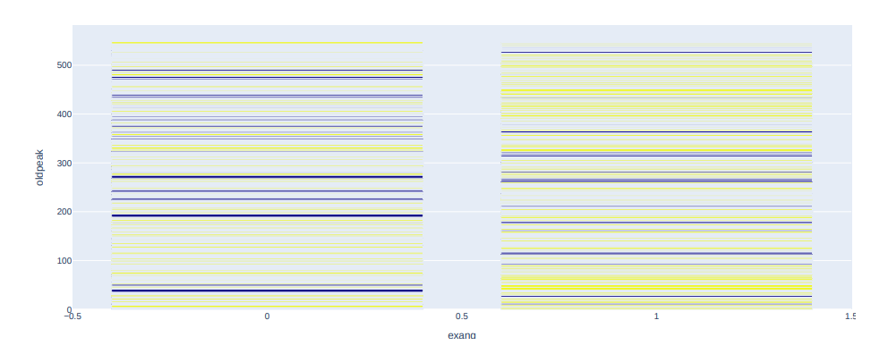
Bar Plot (Exercise-Induced Angina and ST Depression)
Description: Multiple box plots displaying the distribution of various variables (`thalach`, `exang`, `oldpeak`, `slope`, `ca`, `thal`).
Usage: These plots summarize the central tendency, spread, and outliers for each variable.

Slide 14
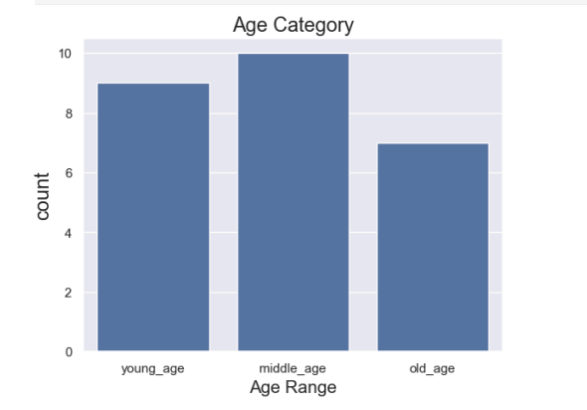
Bar Plot
The line plot effectively communicates the relationship between age categories and actual age, differentiated by sex. It serves as a useful tool for analyzing demographic data related to heart disease, highlighting important trends and differences that can inform further research and health strategies.

Slide 15
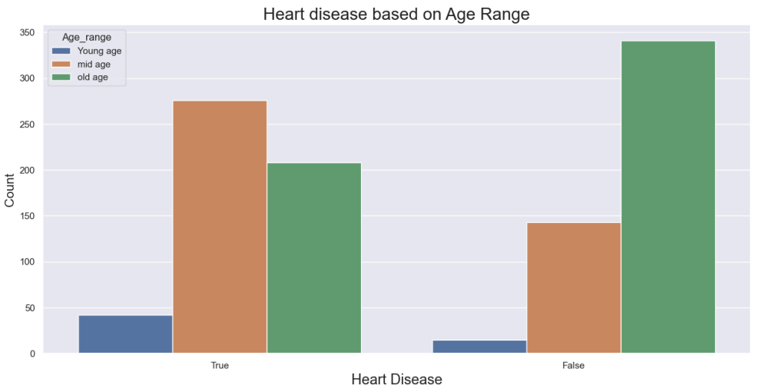
Count Plot Showing Heart Disease Based on Age Range
The count plot effectively communicates the relationship between age and heart disease prevalence. It serves as a crucial tool for analyzing demographic data related to heart disease, revealing important trends and differences that can inform further research and health strategies. Understanding how age impacts heart disease risk is vital for developing effective prevention and treatment approaches

Slide 16
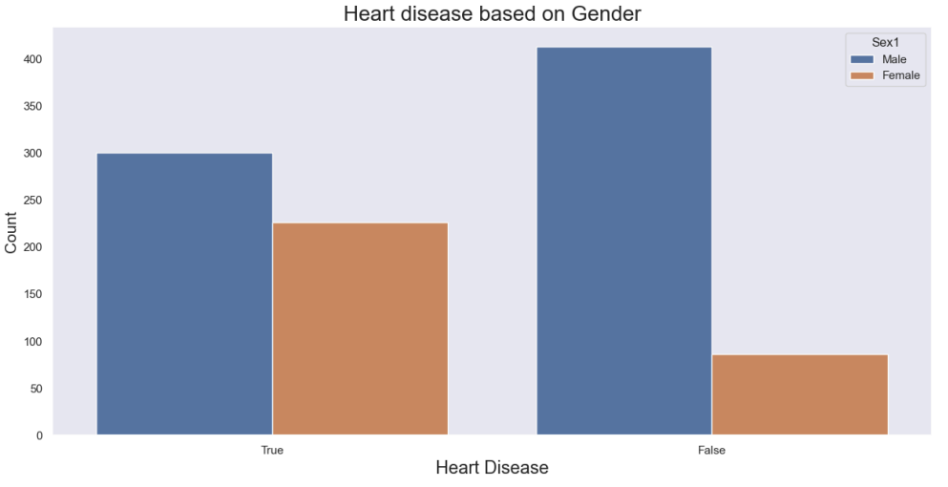
Count Plot Showing Heart Disease Based on Gender
The count plot effectively communicates the relationship between gender and heart disease prevalence. It serves as a crucial tool for analyzing demographic data related to heart disease, revealing important trends and differences that can inform further research and health strategies. Understanding how gender influences heart disease risk is vital for developing effective prevention and treatment approaches.

Slide 17
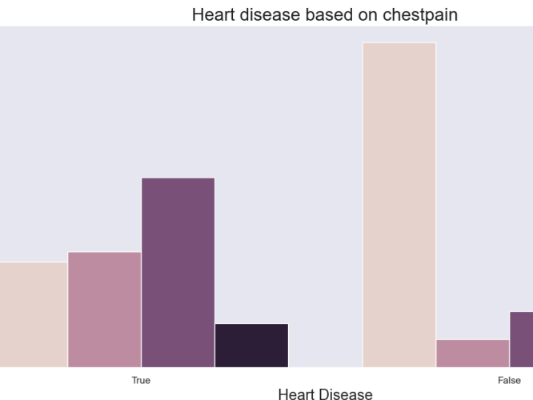
Count Plot Showing Heart Disease Based on Chest Pain
The count plot effectively communicates the relationship between chest pain types and heart disease prevalence. It serves as a crucial tool for analyzing demographic data related to heart disease, revealing important trends and differences that can inform further research and health strategies. Understanding how chest pain types influence heart disease risk is vital for developing effective prevention and treatment approaches.

Slide 18
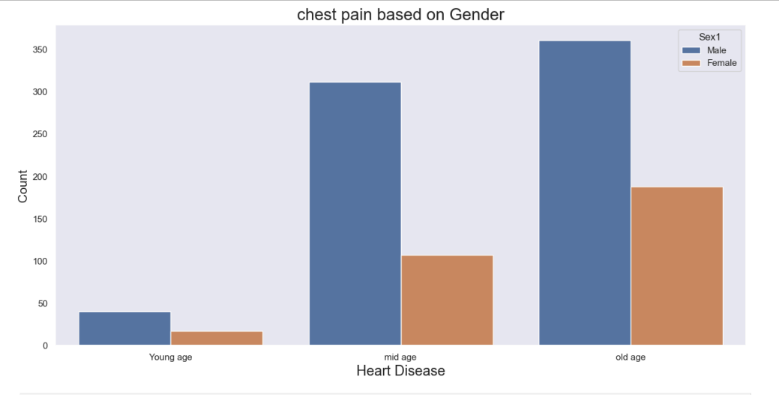
Count Plot Chest Pain Based on Gender Across Different Age Ranges
The count plot effectively communicates the relationship between chest pain types, age ranges, and gender. It serves as a crucial tool for analyzing demographic data related to heart disease, revealing important trends and differences that can inform further research and health strategies. Understanding how chest pain types vary by age and gender is vital for developing effective prevention and treatment approaches.

Slide 19
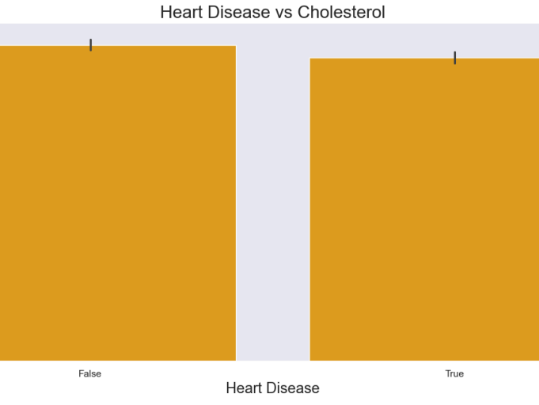
Relationship Between Heart Disease and Cholesterol Levels
The bar plot effectively communicates the relationship between heart disease and cholesterol levels. It serves as a crucial tool for analyzing demographic data related to heart disease, revealing important trends and differences that can inform further research and health strategies. Understanding how cholesterol levels impact heart disease risk is vital for developing effective prevention and treatment approaches.

Slide 20
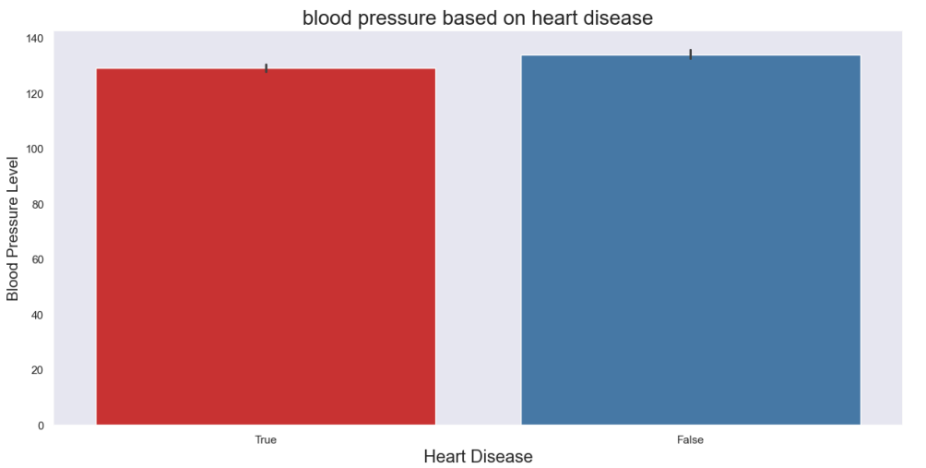
Blood Pressure Levels Based on Heart Disease
The bar plot effectively communicates the relationship between heart disease and blood pressure levels. It serves as a crucial tool for analyzing demographic data related to heart disease, revealing important trends and differences that can inform further research and health strategies. Understanding how blood pressure levels impact heart disease risk is vital for developing effective prevention and treatment approaches.

Slide 21
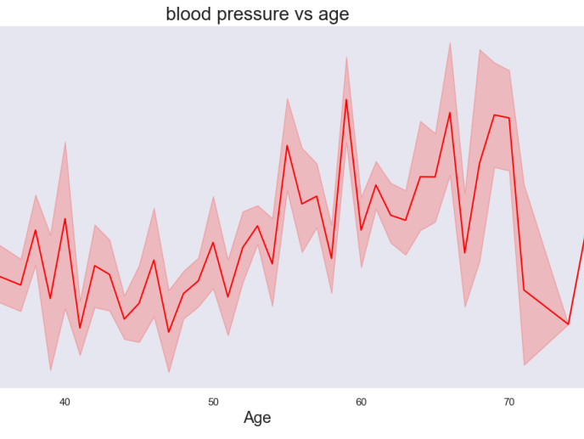
Line Plot Showing Blood Pressure Levels in Relation to Age
The line plot effectively communicates the relationship between age and blood pressure levels. It serves as a crucial tool for analyzing demographic data related to cardiovascular health, revealing important trends that can inform further research and health strategies. Understanding how blood pressure levels change with age is vital for developing effective prevention and treatment approaches for hypertension and related health issues.

Slide 22
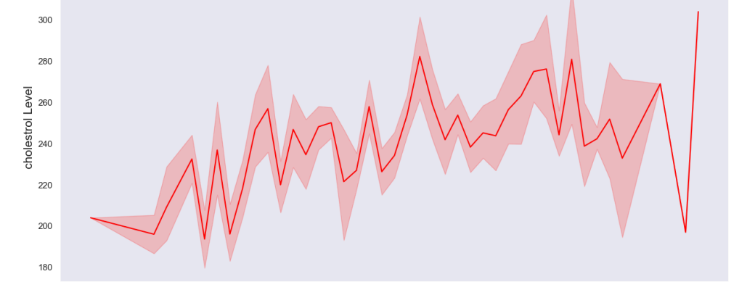
Line Plot Showing the Relationship Between Age and Cholesterol Levels
The line plot effectively communicates the relationship between age and cholesterol levels. It serves as a crucial tool for analyzing demographic data related to cardiovascular health, revealing important trends that can inform further research and health strategies. Understanding how cholesterol levels change with age is vital for developing effective prevention and treatment approaches for hyperlipidemia and related health issues.

Slide 23
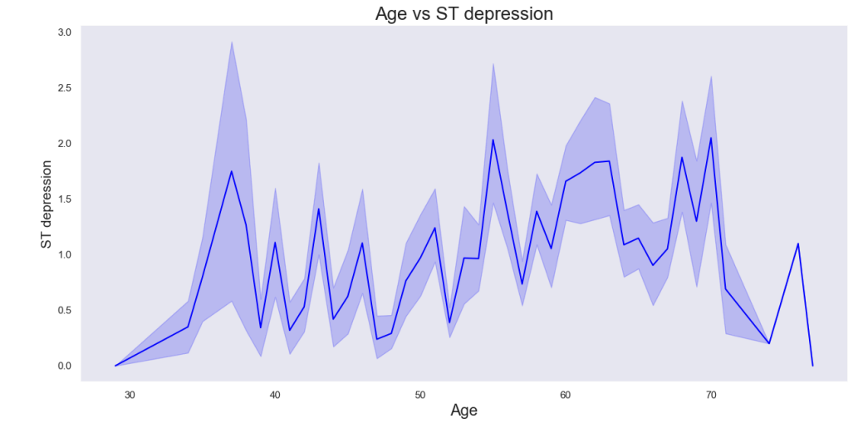
Age vs. ST Depression
The graph effectively communicates the relationship between age and ST depression. It serves as a crucial tool for analyzing cardiovascular health data, revealing important trends that can inform further research and health strategies. Understanding how ST depression levels change with age is vital for developing effective prevention and treatment approaches for heart disease and related conditions.

Slide 24
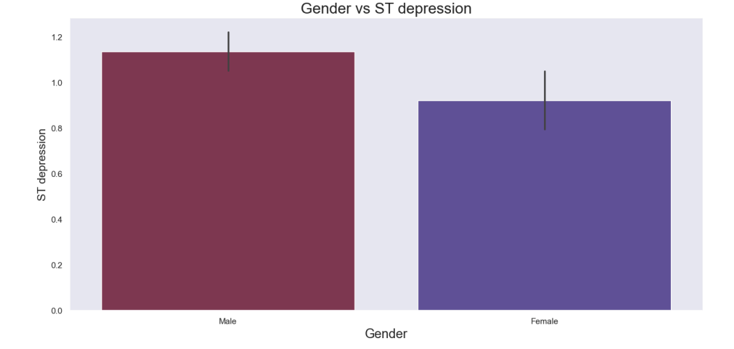
Graph Showing Gender vs. ST Depression
The graph effectively communicates the relationship between gender and ST depression. It serves as a crucial tool for analyzing cardiovascular health data, revealing important trends that can inform further research and health strategies. Understanding how ST depression levels differ by gender is vital for developing effective prevention and treatment approaches for heart disease and related conditions.

Slide 25

THANKYOU

